Slide 1
Green – Circularity oriented systems structure

Slide 2
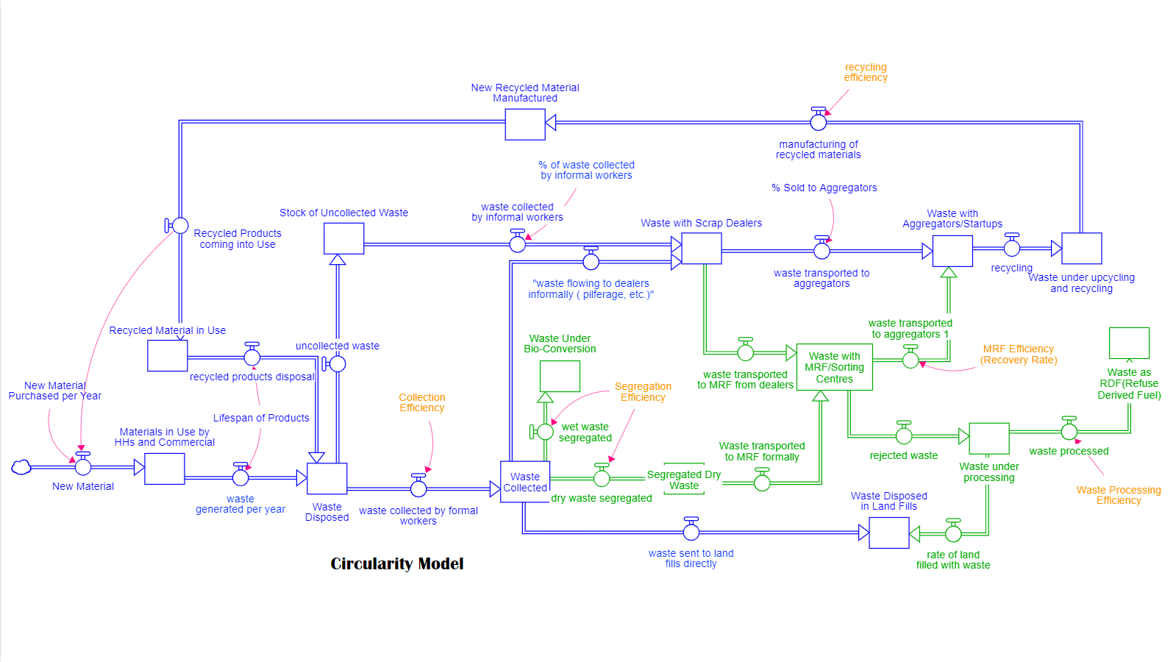
Recyclers
Scrap Dealers
Aggregators
Informal Waste Collectors
MRFs/Sorting Centres
Waste Processors
Consumers and Bulk Waste Generators
Formal Waste Collectors
Waste Transporters

